Slide 1
ECON 672
Week 7: Regression Discontinuity Design
Samuel Rowe, PhD 1/12/2023

Slide 2
Overview
Takeaway
DAG
Visualization of RDD
Sharp RDD
Fuzzy RDD
Challenges to Identification
Example: Close Elections

Slide 3
Overview of RDD
Intuition of RDD
Units around an arbitrarily defined cutoff are similar to one another along a continuous variable
We expect to see a discontinuous jump in the outcome at the cutoff along the running variable
We can calculate an average treatment effect for this subpopulation around the cutoff (LATE)
Growth in popularity in recent years
Ever since Black (1999) utilizes a RDD with geographic discontinuities for school zoning districts to estimate willingness to pay for “better” schools, RDD has grown in popularity
Lee and Lemieux (2010) practical guide has been cited thousands of times

Slide 4
The Takeaway
Pros
The most credible quasi-experimental design strategy
Most assumptions are directly or indirectly testable
Graphical approach to an identification strategy
Cons
You need deep institutional knowledge about the treatment, cutoff/threshold, running variable, and outcomes
LATE cannot be extrapolated to the general population, only those around the cutoff
You need lots of data around the cutoff/threshold

Slide 5
The Takeaway
Assumptions of RDD
Continuity Assumption (Sharp and Fuzzy)
This is indirectly testable by looking for bunching around the cutoff
Fuzzy RDD Only
Exclusion Restriction Assumption - not testable
Monotonicity Assumption - testable
Non-Zero 1st Stage Assumption - testable
Stable Unit Treatment Value Assumption (SUTVA) - not testable

Slide 6
The Takeaway
Assumptions of RDD
Testing Assumptions - Continuity Assumption
McCrary Test
Test for bunching (density) on one side of the cutoff compared to the other side
Covariate Balance Test
Covariates on observables should be balanced on both sides of the cutoff
There should be no discontinuous jumps in covariates, only the outcome
Placebo Test
Testing for discontinuous jumps in the running variable when there shouldn’t be any

Slide 7
Definitions
Running variable or forcing variable
The continuous variable that determines treatment and control
Cutoff/threshold
The assignment rule into treatment or control by an arbitrary rule along the running variable
Bandwidth/Windows
The area or window around the cutoff that you are comparing
Bins
The regular intervals to estimate means within the specified intervals along the running variable
Sharp RDD
The running variable is deterministic of assignment into treatment and control
Fuzzy RDD
The running variable is probabilistic of assignment into treatment and control

Slide 8
Regression Discontinuity DAG

Slide 9
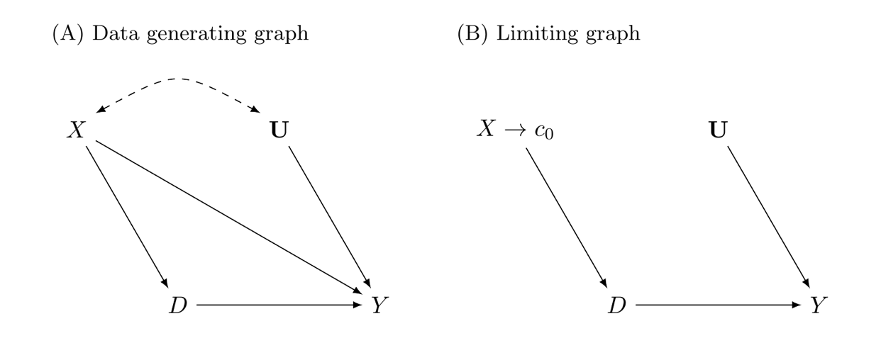
Regression Discontinuity DAG
RDD is a popular design because it is very convincing for the identification of the causal effect by eliminating selection bias on observed and unobserved confounders
If RDD is successful in eliminating selection bias, we are able to retrieve the LATE for a subpopulation

Slide 10
Regression Discontinuity DAG
Data Generating Graph
Without a cutoff (A) we have several backdoor that prevent us from identifying the impact of $D$
Key Point
The running variable $X$ assigns treatment so we do have have overlap
We cannot just control for $X$ even if $U$ was not present - no overlap

Slide 11
Regression Discontinuity DAG
(A) Direct Pathway
$$D→Y$$
(A) Indirect Pathways
$X$ is a continuous variable that assigns treatment and control
$$D←X→Y$$
We also have $U$, which may be observed or unobserved
$$D←-U-→Y$$

Slide 12
Regression Discontinuity DAG
(B) Limiting Graph - Add Cutoff
We can identify the causal effect $(D→Y)$ for those around the cutoff $c_{0}$
The cutoff blocks the backdoor pathway from $X→Y$
We cutoff off the backdoor pathway by utilizing the limit near $c_{0}$
We still have the running variable determine treatment and control
Cutoff $X$ onto $Y$
$$D←X→c_{0}$$
Only works if continuity assumption is satisfied

Slide 13
Cutoff
The cutoff $c_{0}$ rule
An assignment along the running variable $X$ determines assignment into treatment and control depending upon which side of the cutoff $c_{0}$ the observation is on
For example
If someone scores an 0.08 blood alcohol content then assigned drunk driving, but if someone is 0.078 then not
250K in receipts will be assigned one treatment
Test score will have cutoffs for admissions
Key Point
The continuity assumption must be satisfied at the cutoff

Slide 14
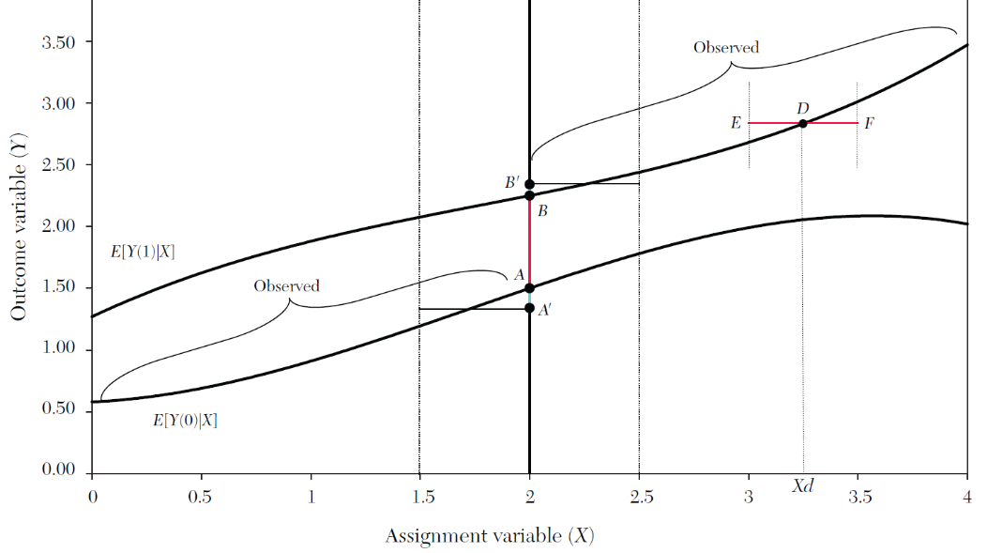
Continuity Assumption
The continuity assumption states that potential outcomes need to be continuous at the cutoff $c_{0}$
The cutoff rule cannot be endogenous to other treatments near the cutoff
$E[Y^{0}]$ and $E[Y^{1}]$ need to be smooth at $c_{0}$
“Nature does not make jumps” or a turtle on a fencepost is not natural
A discontinuous jump will be from $E[Y^{0}|D=0]$ to $E[Y^{1}|D=1]$ due to treatment
We never observe $E[Y^{0}|D=1]$ or $E[Y^{1}|D=0]$

Slide 15
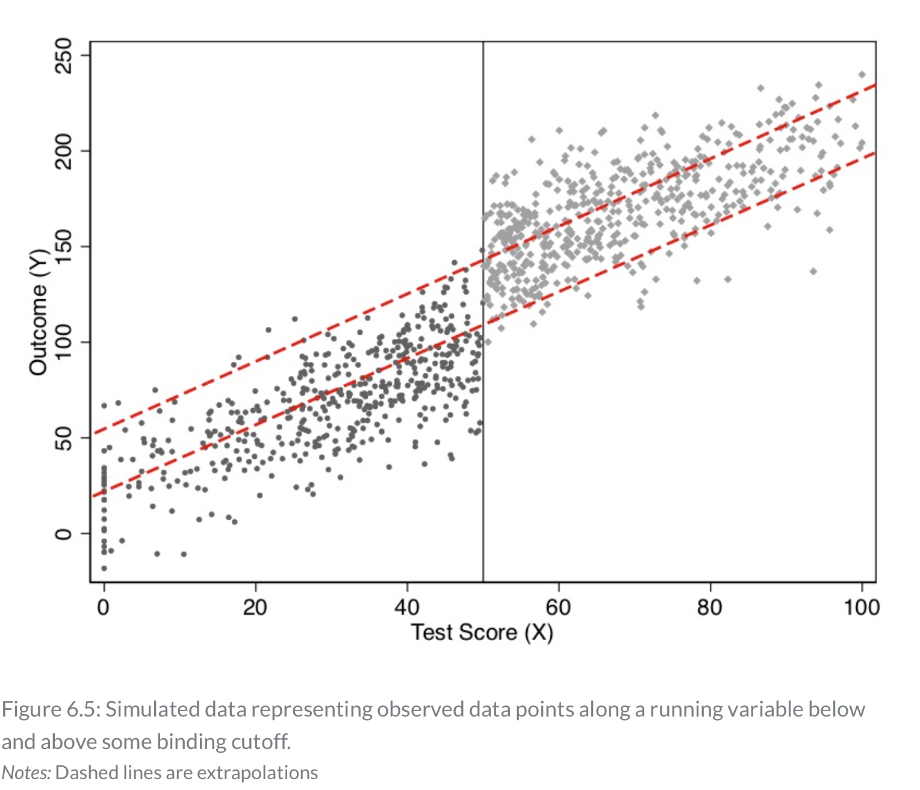
Continuity Assumption
We have to extrapolate $E[Y^{0}|D=1]$ and $E[Y^{1}|D=0]$
We assume a smooth continuous function of $E[Y^{1}|X=c_{0}]$ and $E[Y^{0}|X=c_{0}]$
The treatment causes the jump from the $E[Y^{0}|X]$ line to the $E[Y^{1}|X]$ line at $c_{0}$

Slide 16
Visualization of RDD
Example from Hoekstra (2009)

Slide 17
Visualization of RDD Example
RDD is a very visual research design
Hoekstra (2009) provides an example of using a Fuzzy RDD
He wants to assess heterogenous returns across public colleges
We might expect self-selection into different universities with students with higher abilities self-selecting into state flagship universities
Higher returns to education from state flagships vs state regional might just be a reflection of student’s unobserved ability

Slide 18
Visualization of RDD Example
There are 4 things we need to consider
1) the running variable
2) bins
3) functional form
4) the discontinuous jump at the cutoff

Slide 19
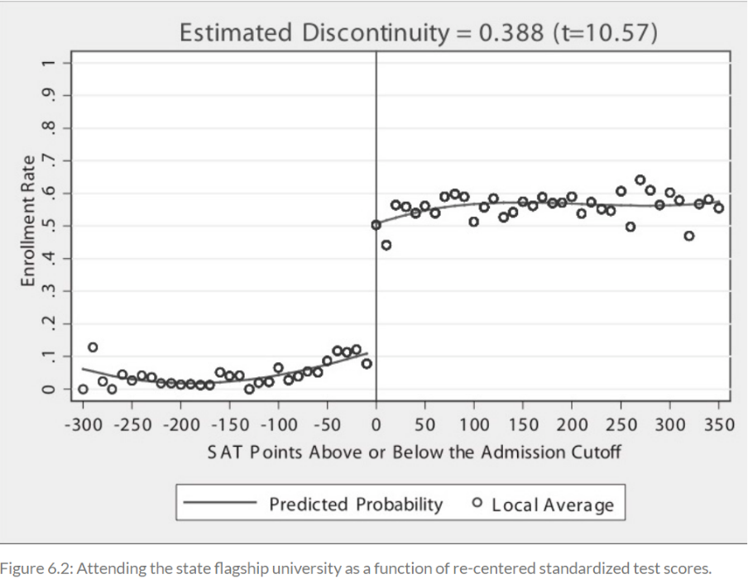
Visualization of RDD Example
1st Stage of Fuzzy RDD is the probability of assignment
Enrollment increases by 0.388 percentage points at $c_{0}$

Slide 20
Visualization of RDD Example
Hoekstra (2009) utilizes running variable
The SAT score as the running variable and the admission cutoff as the cutoff rule $c_{0}$, where $c_{0}$ is determined by the admissions department and re-centered to zero
The bins size
Regular intervals to assess the probability of admission along the running variable
Each dot represents the probability of admission within the bin/interval of SAT scores
The functional form
There are two curved lines (not linear), with one line fitted on each side of the cutoff score
The functional form here is takes on a higher order terms (such as $x^{2},x^{3},...,x^{p}$)

Slide 21
Visualization of RDD Example
Imagine two students with an SAT score of 1240 and 1250
It is likely that these two particular student differ quite a bit
However, if we have hundreds of students with SAT scores of 1240 and 1250, these students are less likely to have differences among observed and unobserved characteristics
Reflection Questions
Should students with SAT scores of 1240 and 1250 differ that much in large samples?
Do administrators know of a large jump in ability at the cutoff or is the natural ability continuous around the cutoff?

Slide 22
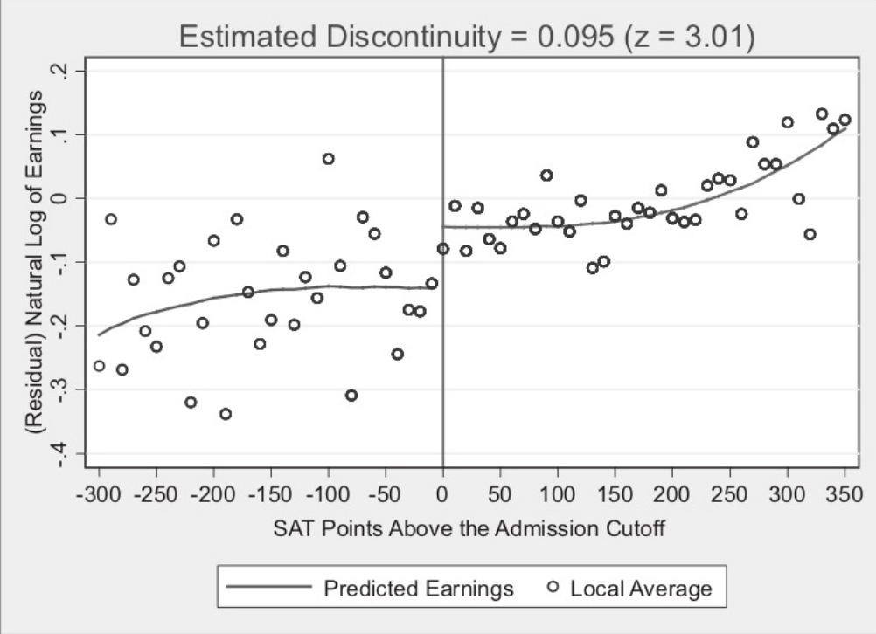
Visualization of RDD Example
2nd Stage with Fuzzy RDD
Admission into the state flagship university increased earnings by $(e^{0.095}-1)≈0.1$
Depending upon the window size, earnings increased by 7.4% to 11.1% ten to fifteen years after admission

Slide 23
Data Requirement for RDD
Acquiring Data
Acquiring can be very challenges, especially for administrative data
Hoekstra (2009) had gain trust and build relationships with program administrators
This is not too different from federal evaluations when working with program staff
The secret sauce of RDD
Gaining access to subject-matter experts on the data and the data itself requires a lot of soft skills (e.g.: building trust and relationships)
It take a lot time compared to downloading publicly available data and reading documentation

Slide 24
Data Requirement of RDD
Where do we find jumps?
We can find jumps embedded in arbitrary rules set by people
It is possible that firms and government agencies are sitting unknowingly on top of lots of data that can be utilized for an RDD
Key Points
The assignment rule or cutoff rule ($c_{0}$) needs to be free from manipulation
We need lots of data around the cutoff and its a main feature of RDD

Slide 25
Sharp RDD

Slide 26
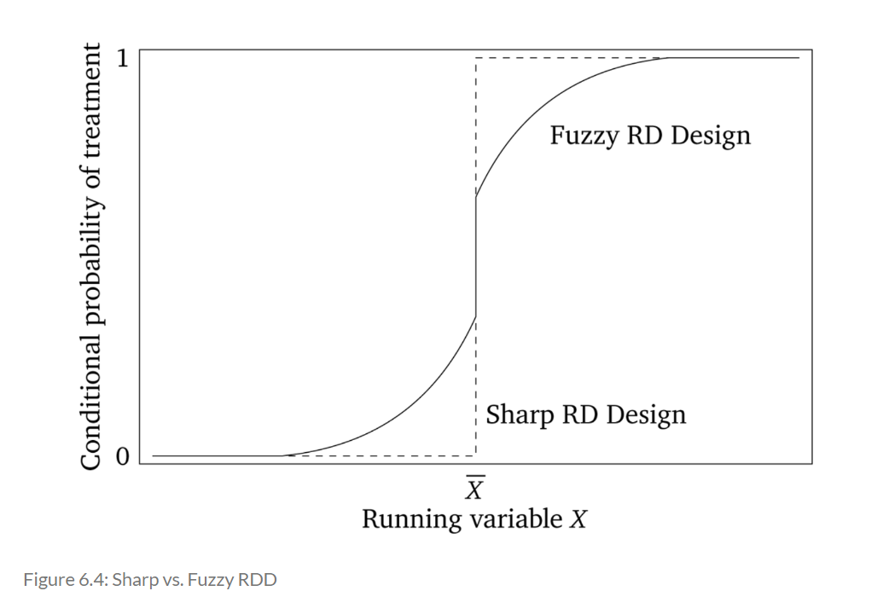
Sharp RDD
The first type of RDD we will discuss is the Sharp RDD
Why is it called Sharp RDD?
Because the assignment rule is deterministic of assignment
$E[D|X>=c_{0}]=1$ and $E[D|X<c_{0}]=0$

Slide 27
Sharp RDD
Sharp RDD status is deterministic and a discontinuous function of X
$$D_{i}=\{\begin{aligned}1ifX_{i}≥c_{o} \\ 0ifX_{i}<c_{0}\end{aligned}$$
Where $c_{0}$ is our known threshold or cutoff rule
$X$ perfectly predicts assignment into treatment or control
Key Point
There is no overlap between treatment and control in Sharp RDD

Slide 28
Sharp RDD
Potential Outcome Notation
Assume constant treatment effects or homogenous treatment effects
$$Y_{i}^{0}=α+βX_{i}$$
$$Y_{i}^{1}=Y_{i}^{0}+δ$$
This gives us a switching equation
$$Y_{i}=Y_{i}^{0}+(Y_{i}^{1}-Y_{i}^{0})D_{i}$$
$$Y_{i}=α+βX_{i}+δD_{i}+ε_{i}$$

Slide 29
Sharp RDD
Potential Outcome Notation
The treatment effect parameter, $δ$, is the discontinuity in the conditional expectation function
$δ=\lim_{c_{0}←x_{i}}E[Y_{i}^{1}|X_{i}=c_{0}]-\lim_{x_{i}→c_{0}}E[Y_{i}^{0}|X_{i}=c_{0}]$ $=\lim_{c_{0}←x_{i}}E[Y_{i}|X_{i}=c_{0}]-\lim_{x_{i}→c_{0}}E[Y_{i}|X_{i}=c_{0}]$
We can identify the causal effect by approaching the limit from both sides of the running variable at the cutoff $c_{0}$

Slide 30
Sharp RDD
Local Average Treatment Effects (LATE)
$δ_{SRD}$ is interpreted as a local estimate of the treatment effects
Why? Because we only have overlap at the limit between treatment and control
Only identifying causal effects on a subpopulation is very similar to IV compliers
In Sharp RDD, our subpopulation is not compliers,
Our subpopulation is at the limit as $X→c_{0}$ from both sides
We do not have overlap beyond the limit
$$δ_{SRD}=E[Y_{i}^{1}-Y_{i}^{0}|X_{i}=c_{0}]$$

Slide 31
Sharp RDD
Continuity Assumption plus Stata Exercise
The key assumption in Sharp RDD is the continuity assumption
That is saying that $E[Y^{1}|X=c_{0}]$ and $E[Y^{0}|X=c_{0}]$ are smooth continuous functions of $X$
$E[Y^{0}|D=1]=E[Y^{0}|D=0]$ and $E[Y^{1}|D=1]=E[Y^{1}|D=0]$
The continuity assumption rules out observed and unobserved omitted variable bias at the cutoff, since confounders are continuous at the cutoff
Key Point
In the absence of treatment the functions would remain smooth and continuous and no jumps would have occurred
If a discontinuous jumps occurs in any confounder (observed or unobserved), then the continuity assumption is violated

Slide 32
Sharp RDD
Testing the Continuity Assumption
We cannot directly test the continuity assumption, but there are a few method we can employ
We don’t have potential outcomes to test directly, but we can test indirectly
An SME with deep-institutional knowledge should know if something else besides the treatment is causing a jump at the cutoff $c_{0}$
Placebo tests
Testing a fake cutoff, such as $c_{0}+n$ or $c_{0}-n$
Testing continuity in covariates at the cutoff
Covariates should be smooth and continuous at the cutoff $c_{0}$
McCrary Test
There should be do difference in the density of observations at the cutoff $c_{0}$

Slide 33
Sharp RDD
Estimating the LATE using Sharp RDD
There are a few ways to estimate the LATE using RDD
This will require specification tests
Transforming the cutoff
Global vs Local
What is your window and what are your bins
Functional Forms
Linear
Pth-order polynomial
Non-parametric kernel

Slide 34
Sharp RDD
Estimating Sharp RDD
3 Steps
Step 1: Recenter your running variable
Step 2: Local vs Global (Variance-Bias Trade Off)
Step 3: Functional Form

Slide 35
Sharp RDD
1st Step: Transform running variable
The first step is to transform the running variable
Recenter the running variable around the cutoff $c_{0}$
$$Y_{i}=α+β(X_{i}-c_{0})+δD_{i}+ε_{i}$$
This only changes the intercept, not $δ_{SRD}$
For example
$$Y=β_{0}+β_{1}(Age-65)+β_{2}Edu+ε$$
$$Y=β_{0}+β_{1}Age_{i}+β_{1}65+β_{2}Edu+ε=(β_{0}+β_{1}65)+β_{1}Age+β_{2}Edu+ε$$
$Y=α+β_{1}Age+β_{2}Edu+ε$, where $α=β_{0}+β_{1}65$

Slide 36
Sharp RDD
Step 2: Global vs Local
Also known as Variance-Bias Trade-off
Global typically means all of the data you have
Local typically means restricting the data to a specified window around the cutoff
We lose observations
You typically want to focus on the local
However, it is good to include for specification tests
Global regression may influence your averages on both sides of the cutoff

Slide 37
Sharp RDD
Step 3: Functional Form
What is the functional form, specification, or data-generation process?
If we do not properly specify the functional form, we may estimate spurious discontinuous jumps
The jumps may not exist since the data-generation process was in a different function form
The data-generation process could have been:
Linear specification
$p^{th}$ order specification
Non-parametric specification

Slide 38
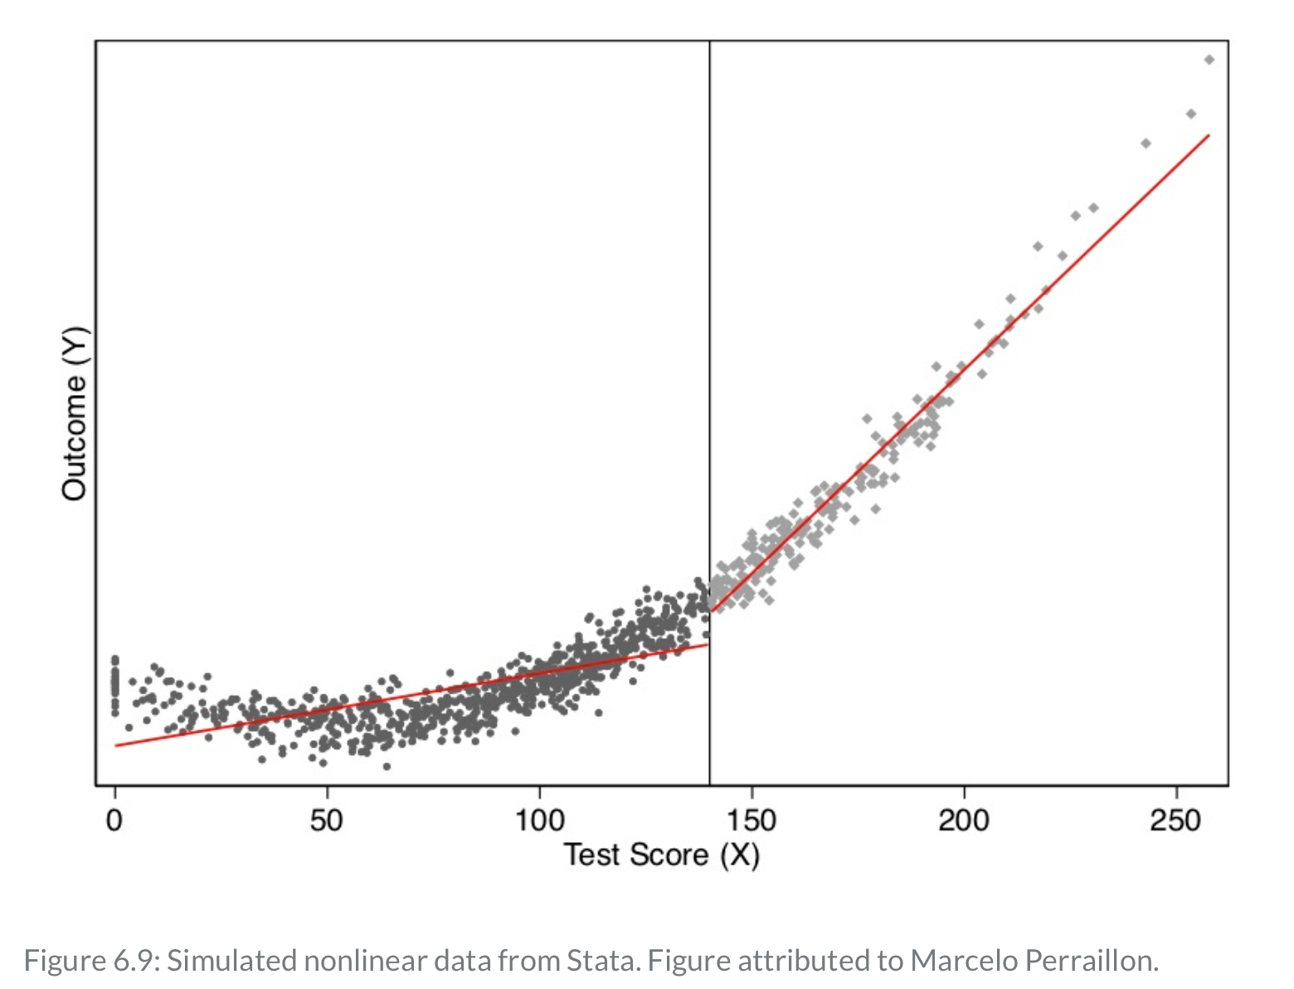
Sharp RDD
Step 3: Functional Form
Figure 6.9 shows what happens when you incorrectly specify the functional form
Here we use a linear functional form when the data-generation process was non-linear
Using a linear functional form on a $p^{th}$ order polynomial will result in a spurious discontinuous jump at $c_{0}$

Slide 39
Sharp RDD
Step 3: Functional Form
What happens when the data-generation process is non-linear?
Use $p^{th}$ order polynomial
Use non-parametric kernel
If we have a non-linear specification (or relationship)
$$E[Y_{i}^{0}|X_{i}]=f(X_{i})$$
If we have $f(X_{i})$ as a smooth, continuous function, we fit the model
$$Y_{i}=f(X_{i})+δD_{i}+η_{i}$$
Use $p^{th}$ order polynomial or non-parametric kernel

Slide 40
Sharp RDD
Step 3: Functional Form - $p^{th}$ order
Using a $p^{th}$ order model for $f(X_{i})$
$$Y_{i}=α+β_{1}x_{i}+β_{2}x_{i}^{2}+...+β_{p}x_{i}^{p}+δD_{i}+η_{i}$$
Key Note:
Higher-order polynomials may result in overfitting which introduces bias
German and Imbens (2019) suggest using linear or quadratic $(p=2)$ for local linear regressions

Slide 41
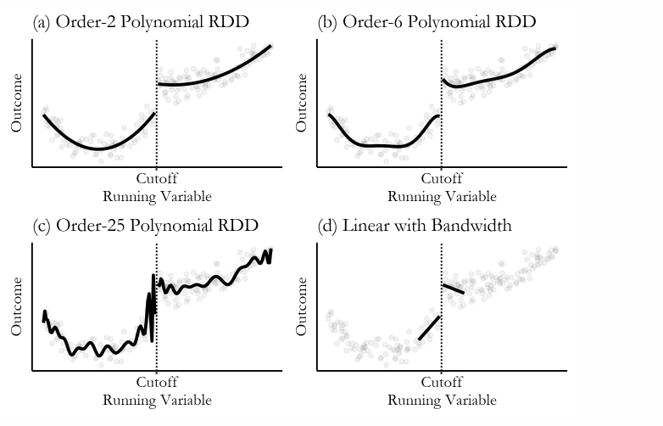
Sharp RDD
Step 3: Functional Form - $p^{th}$ order
Huntington-Klein (2021) provides a nice example of overspecification with higher polynomial orders
Try to stick with linear or quadratic

Slide 42
Sharp RDD
Step 3: Functional Form - $p^{th}$ order
Allow for $f(X_{i})$ to differ on both sides of the cutoff
$$E[Y_{i}^{0}|X_{i}]=α+β_{01}{\overset{˜}{X}}_{i}+...+β_{0p}{\overset{˜}{X}}_{i}^{p}$$
$$E[Y_{i}^{1}|X_{i}]=α+δ+β_{11}{\overset{˜}{X}}_{i}+...+β_{1p}{\overset{˜}{X}}_{i}^{p}$$
Where ${\overset{˜}{X}}_{i}=(X_{i}-c_{o})$
Using potential outcomes switching equation
$$E[Y|X]=E[Y^{0}|X]+(E[Y^{1}|X]-E[Y^{0}|X])D$$

Slide 43
Sharp RDD
Step 3: Functional Form - $p^{th}$ order
Derive the regression model
$$Y_{i}=α+β_{01}{\overset{˜}{X}}_{i}+...+β_{0p}{\overset{˜}{X}}_{i}^{p}+δD_{i}+β_{11}D_{i}{\overset{˜}{X}}_{i}+...+β_{1p}D_{i}{\overset{˜}{X}}_{i}^{p}+ε_{i}$$
We interact the continuous variable, $\overset{˜}{X}$ with our treatment variable $D$
Allows for a discontinuous jump and $p^{th}$ order polynomial
Our treatment effect of interest is $δ$ at $c_{0}$

Slide 44
Sharp RDD
Step 3: Functional Form - Non-parametric Kernel
The other non-linear option is a non-parametric kernel
German and Imbens (2019) suggest avoiding $p^{th}$ order polynomials beyond quadratic when estimating local regressions
Kernel regressions are an alternative to $p^{th}$ order polynomials, but there are draw backs
Kernel Regression
A kernel is a function describing how values are weighted
A kernel regression is a weighted regression within a specified window

Slide 45
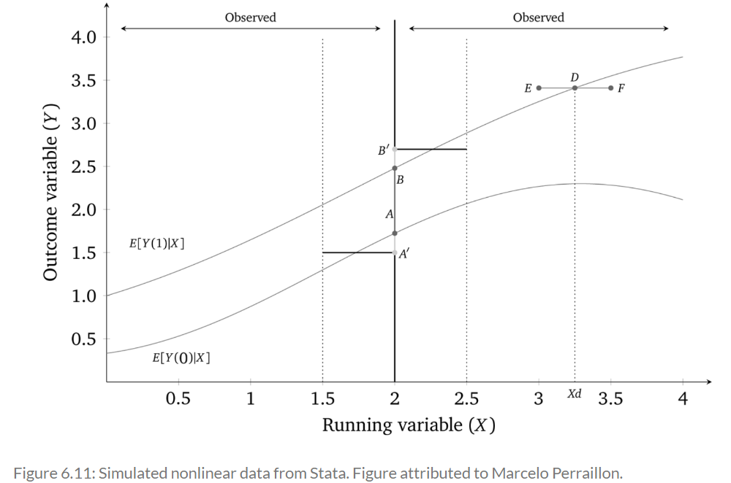
Sharp RDD
Step 3: Functional Form - Non-parametric Kernel
A rectangle kernel gives the same weight within the bandwidth (window) along the running variable $X$
You can see that the true discontinuous jump is $AB$, but the rectangle kernel estimates $A^{′}B^{′}$, which is upwards biased

Slide 46
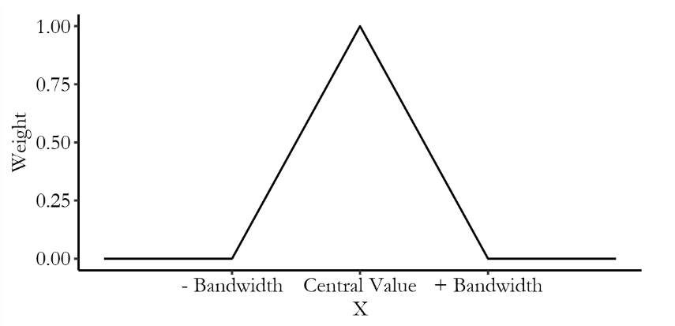
Sharp RDD
Step 3: Functional Form - Non-parametric Kernel
A triangular kernel gives more weight within the bandwidth (window) as the running variable $X$ gets closer to the cutoff
One way to deal with the boundary issue is to run a local linear nonparametric regression (Hahn, Todd, and Klaauw, 2001)

Slide 47
Sharp RDD
Step 3: Functional Form - Non-parametric Kernel
A typical kernel regression is $(\overset{̂}{a},\overset{̂}{b})=argmin_{a,b}∑(y_{i}-a-b(x_{i}-c_{0}))^{2}K(\frac{x_{i}-c_{0}}{h})1(x_{i}>c_{0})$
Where $argmin_{a,b}∑(y_{i}-a-b(x_{i}-c_{0}))^{2}$ is just minimizing the sum of squares
Where $K(\frac{x_{i}-c_{0}}{h})$ is our kernel function and $h$ is our width of the window
Where $1(x_{i}>c_{0})$ is a binary function (on-off switch)

Slide 48
Sharp RDD
Inference
The standard practice in RDD is to estimate the causal effects using local polynomial regressions around the cutoff (this include p=1)
Variance-Bias Trade-off
If you narrow a window enough, you will minimize misspecification bias, but you will have larger variance due to smaller sample size
Expand the window will reduce variance, but increase misspecification bias
What if the window cannot be narrowed
Heteroskedasticity-robust confidence intervals (RDHonest in R)
May use random inference

Slide 49
Example: Medicare and Universal Health Insurance
Card, Dobkin, and Maestas (2008)
What is the impact of universal health insurance for the elderly?
Does better insurance cause better health outcomes?
There is a lot self-selection into health insurance or higher quality insurance
Card, et al. (2008) find that Medicare increases access to health insurance for underserved groups
Running variable and cutoff
Age is the running variable
Sharp cutoff at age of 65 for Medicare eligibility
If the continuity assumption holds, then there is a discontinuous jump in health insurance at age 65

Slide 50
Example: Medicare and Universal Health Insurance
Card, Dobkin, and Maestas (2008)
The authors specify the model for causal effect of health-care insurance on health-care utilization
$y_{ija}=X_{ija}α+f_{j}(α,β)+\underset{K}{∑}C_{ija}^{k}δ^{k}+u_{ija}$
Where $i$ is individual, $j$ is socioeconomic status, and $a$ is age
$y_{ija}$ is health care usage
$X_{ija}$ is a set of covariates
$f_{j}(α,β)$ is a smooth function representing the age profiles of outcome $y$ for group $j$
$C_{ija}^{k}$ are $k$ number of characteristics of insurance coverage, such as copayments, etc.

Slide 51
Example: Medicare and Universal Health Insurance
Card, Dobkin, and Maestas (2008)
Let’s assume that insurance can be characterized by two characteristics (k=2)
$C^{1}$ is any coverage (0,1) and $C^{2}$ is insurance generosity (0,1)
Card, Dobkin, and Maestas (2008) estimate the following two equations
$C_{ija}^{1}=X_{ija}β_{j}^{1}+g_{j}^{1}(a)+D_{a}π_{j}^{1}+v_{ija}^{1}$
$$C_{ija}^{2}=X_{ija}β_{j}^{2}+g_{j}^{2}(a)+D_{a}π_{j}^{2}+v_{ija}^{2}$$
Where $β_{j}^{k}$ are group-specific coefficients of the set of covariates
Where $g_{j}^{k}(a)$ is a smooth age profiles of group $j$
Where $D_{a}$ is a binary equal to 1 if respondent is greater than or equal to 65

Slide 52
Example: Medicare and Universal Health Insurance
Card, Dobkin, and Maestas (2008)
Let’s combine our 3 equations
$$y_{ija}=X_{ija}(α_{j}+β_{j}^{1}δ_{j}^{1}+β_{j}^{2}δ_{j}^{2})+h_{j}(a)+D_{a}π_{j}^{y}+v_{ija}^{y}$$
Where $h_{j}(a)=f_{j}(a)+δ^{1}g_{j}^{1}(a)+δ^{2}g_{j}^{2}(a)$ is the reduced form age profile
Where $π_{j}^{y}=π_{j}^{1}δ^{1}+π_{j}^{2}δ^{2}$
The magnitude depends upon the size of insurance changes at 65 $(π_{j}^{1}$ and $π_{j}^{2})$ and on the associated causal effects of $(δ^{1}$ and $δ^{2})$
$π_{j}^{y}$ is a linear combination of discontinuities in coverage and generosity
$π_{j}^{y}=δ^{0}+δ^{1}π_{j}^{1}+δ^{2}π_{j}^{2}+e_{j}$

Slide 53
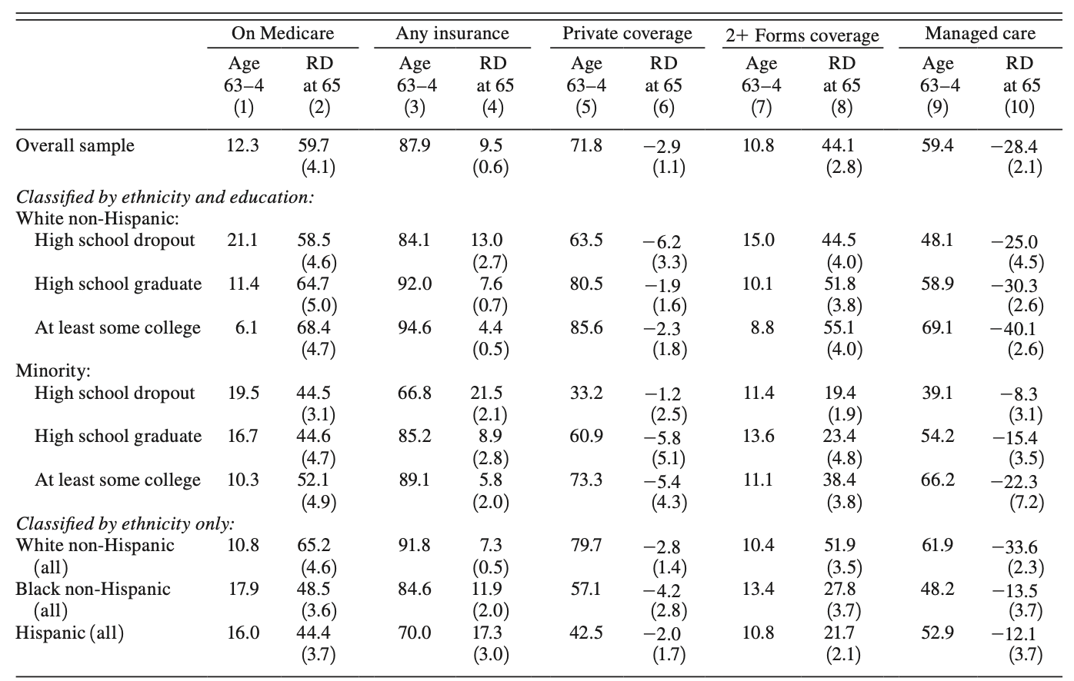
Example: Medicare and Universal Health Insurance
Card, Dobkin, and Maestas (2008)
12.3% of the sample of 63-64 year olds had Medicare which is likely due to disability (1) and Medicare jumps almost 60 percentage points at 65 (2)
Any insurance jumps 9.5 percentage points (3) and -2.9 percentage point drop in private coverage
Non-white high school dropouts experience a 21.5 percentage points increase in any insurance

Slide 54
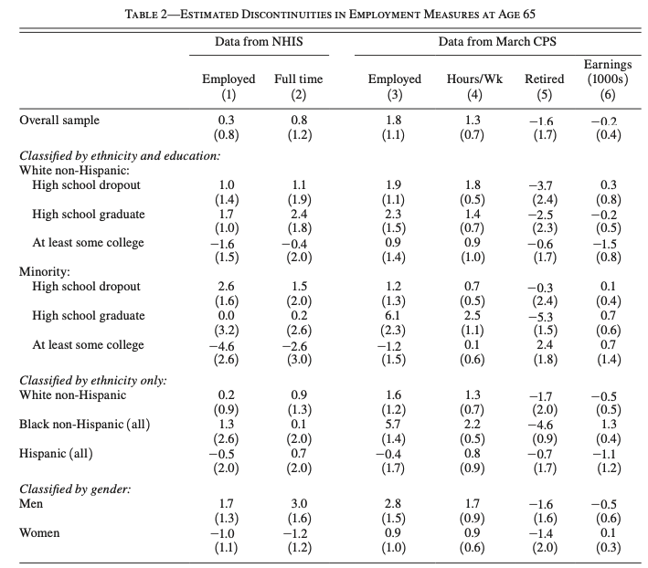
Example: Medicare and Universal Health Insurance
Card, Dobkin, and Maestas (2008)
Testing continuity assumption indirectly
We observe $E[Y^{0}|age]$ before 65 and $E[Y^{1}|age]$ for 65+
$$\lim_{65←a}E[Y^{1}|a]-\lim_{a→65}E[Y^{0}|a]$$
Test employment, since it could be confounding and discontinuous at 65
Jumps in employment measures are small and insignificant

Slide 55
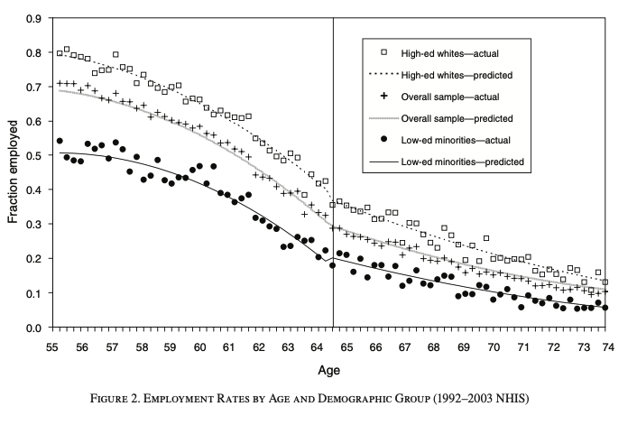
Example: Medicare and Universal Health Insurance
Card, Dobkin, and Maestas (2008)
Testing continuity assumption indirectly with employment

Slide 56
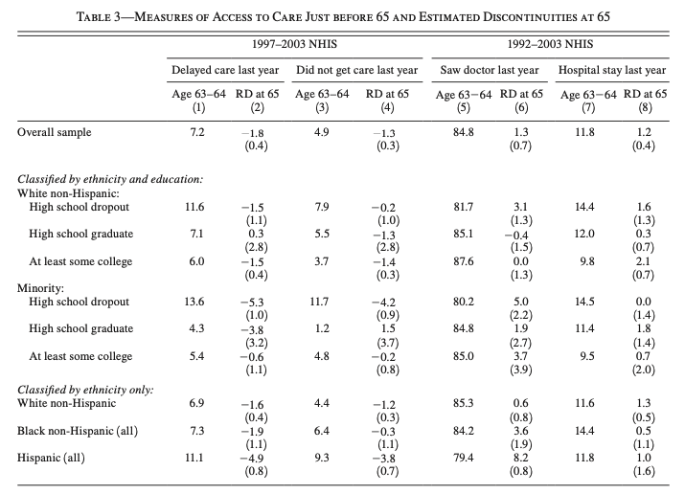
Example: Medicare and Universal Health Insurance
Card, Dobkin, and Maestas (2008)
Jumps in access to healthcare at the cutoff but much smaller magnitudes
Delaying care last year drops 1.8 percentage points and not getting care drops 1.3 percentage points

Slide 57
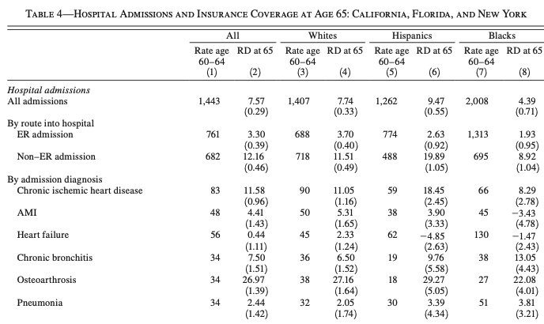
Example: Medicare and Universal Health Insurance
Card, Dobkin, and Maestas (2008)
There is a jump in hospital admissions at the cutoff of 65
This is statistically significant across racial/ethnic groups
There are bigger jumps in non-ER admissions across racial/ethnic groups

Slide 58
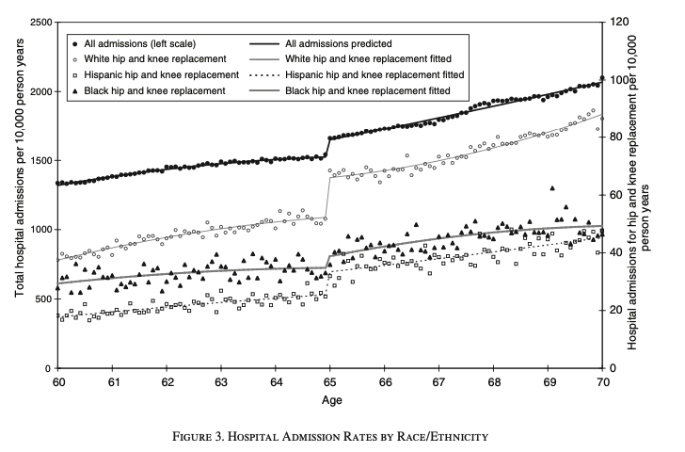
Example: Medicare and Universal Health Insurance
Card, Dobkin, and Maestas (2008)
We can visualize the discontinuous jumps in admission and admission for hip and knee replacements

Slide 59
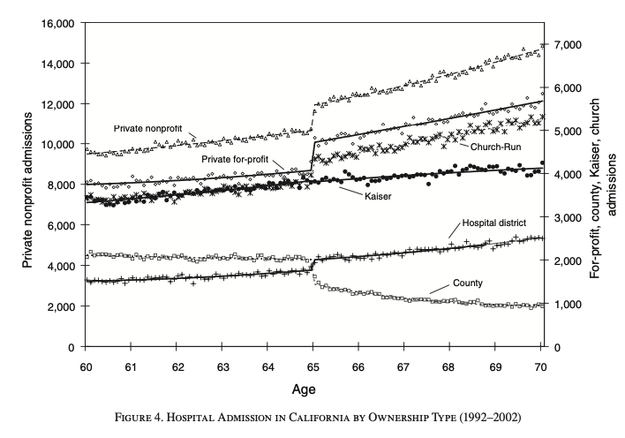
Example: Medicare and Universal Health Insurance
Card, Dobkin, and Maestas (2008)
We see jumps in admission for private hospitals in CA
We see two other patterns
A big declines in county hospital admissions, a redistribution of patients
No change in Kaiser HMO admissions and remain in managed care before and after 65 - no incentive to get high-cost Medicare procedures

Slide 60
Fuzzy RDD

Slide 61
Fuzzy RDD
Overview
Fuzzy RDD differs from Sharp RDD
The running variable is no longer deterministic of assignment to treatment
The running variable is probabilistic in assignment to treatment
The conditional probability of treatment is discontinuous as the running variable approaches at the limit $c_{0}$
Fuzzy RDD has a lot of similarities to Instrumental Variables
Very similar assumptions

Slide 62
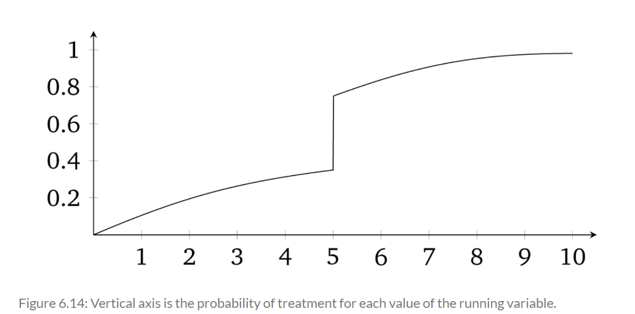
Fuzzy RDD
Overview
The running variable is associated with the probability of assignment to treatment
There is a discontinuous jump in probability to assignment to treatment at $c_{0}$

Slide 63
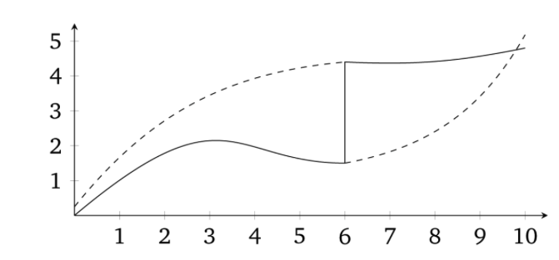
Fuzzy RDD
Overview
When we have an increase in probability of treatment, we have a Fuzzy RDD
$$\lim_{c_{0}←x_{i}}Pr(D_{i}=1|X=c_{0})≠\lim_{x_{i}→c_{0}}Pr(D_{i}=1|X=c_{0})$$
This means that the conditional probability of treatment is discontinuous at the cutoff in the limit
We still have our continuity assumption, where $E[Y^{0}|X<c_{0}]$ and $E[Y^{1}|X≥c_{0}]$ are smooth and continuous

Slide 64
Fuzzy RDD
The Estimator
Estimating the Fuzzy RDD is similar to IV
$$δ_{FuzzyRDD}=\frac{\lim_{c_{0}←X}E[Y|X=c_{0}]-\lim_{X→c_{0}}E[Y|X=c_{0}]}{\lim_{c_{0}←X}E[D|X=c_{0}]-\lim_{X→c_{0}}E[D|X=c_{0}]}$$
Where our first stage is seen in the denominator and reduced form in the numerator
Estimate
We can use a 2SLS for estimating the first stage and then the 2nd stage
Think of $Z$ as the instrument that is 1 when $X≥c_{0}$ and 0 when $X<c_{0}$

Slide 65
Fuzzy RDD
Assumptions
Continuity Assumption (Indirectly Testable)
$E[Y^{0}]$ and $E[Y^{1}]$ are smooth and continuous functions at $X=c_{0}$
Exclusion Restriction Assumption
$Z$ works through $D$ and not other sources; the running variable is not associated with other covariates
Not directly testable, but we can look for discontinuous jumps in observed covariates like Card, et al. (2008)
Monotonicity Assumption (Testable)
Conditional probability of treatment with the running variable The running variable is increasing or decreasing but not both
Stable Unit Treatment Value Assumption (Not Testable)
No spillovers
Non-Zero 1st Stage Assumption (Testable)
There is an associated between the running variable and the conditional probability of treatment

Slide 66
Fuzzy RDD
1st Stage
We can estimate the Fuzzy RDD in two stages or with a reduced form
1st Stage with no interaction
$$D_{i}=γ_{0}+γ_{1}X_{i}+γ_{2}X_{i}^{2}+...+γ_{p}X_{i}^{p}+πZ_{i}+ζ_{i}$$
Where $Z_{i}$ is 1 if $X≥c_{0}$ and 0 if $X<c_{0}$
$π$ is the causal effect of $Z_{i}$ on $D_{i}$
1st Stage with interaction
We can interact $Z_{i}$ with $D_{i}$ to change the slope and the intercept at the cutoff
$$D_{i}=γ_{00}+γ_{01}{\overset{˜}{X}}_{i}+γ_{02}{\overset{˜}{X}}_{i}^{2}+...+γ_{0p}{\overset{˜}{X}}_{i}^{p}+πZ_{i}+γ_{11}{\overset{˜}{X}}_{i}D_{i}+γ_{12}{\overset{˜}{X}}_{i}^{2}D_{i}+...+γ_{1p}{\overset{˜}{X}}_{i}^{p}D_{i}+ζ_{i}$$

Slide 67
Fuzzy RDD
2nd Stage
Once we have fitted our treatment ${\overset{̂}{D}}_{i}$ in our 1st stage we can estimate the LATE at the cutoff
2nd Stage with no interaction
Intercept only changes at the cutoff
$$Y_{i}=α+β_{1}X_{i}+β_{2}X_{i}^{2}+...+β_{p}X_{i}^{p}+δ{\overset{̂}{D}}_{i}+η_{i}$$
2nd Stage with interaction
Slope and intercept change at the cutoff
$$Y_{i}=α+β_{01}{\overset{˜}{X}}_{i}+β_{02}{\overset{˜}{X}}_{i}^{2}+...+β_{0p}{\overset{˜}{X}}_{i}^{p}+δ{\overset{̂}{D}}_{i}+β_{11}{\overset{˜}{X}}_{i}{\overset{̂}{D}}_{i}+β_{12}{\overset{˜}{X}}_{i}^{2}{\overset{̂}{D}}_{i}+...+β_{1p}{\overset{˜}{X}}_{i}^{p}{\overset{̂}{D}}_{i}+η_{i}$$

Slide 68
Fuzzy RDD
Reduced Form
If we want to skip over the full IV model, we can use a reduced form
This identifies the impact of the instrument on the outcome of interest
No interaction reduced form
Only the intercept changes at the cutoff
$$Y_{i}=μ+κ_{1}X_{i}+κ_{2}X_{i}^{2}+...+κ_{p}X_{i}^{p}+δZ_{i}+ζ_{i}$$
Interaction reduced form
Slope and the intercept changes at the cutoff
$$Y_{i}=μ+κ_{01}{\overset{˜}{X}}_{i}+κ_{02}{\overset{˜}{X}}_{i}^{2}+...+κ_{0p}{\overset{˜}{X}}_{i}^{p}+δZ_{i}+κ_{11}{\overset{˜}{X}}_{i}Z_{i}+...+κ_{1p}{\overset{˜}{X}}_{i}^{p}Z_{i}+ζ_{i}$$

Slide 69
Challenges to Identification

Slide 70
Challenges to Identification
Overview
We have many potential avenues where agents can violate the continuity assumption
We cannot directly test the continuity assumption because we never observe $E[Y^{0}|D=1]$ and $E[Y^{1}|D=0]$
We have three main tests at our disposal to indirectly test the continuity assumption
McCrary Test
Covariate Balance
Placebo Tests

Slide 71
Challenges to Identification
Violations of Continuity Assumption
Assignment rule is known in advance
Agents are interested in adjusting around the assignment rule
Agents have time to adjust to the assignment rule
Assignment rule is endogenous with other factors that can potentially impact the outcome
There is nonrandom heaping along the running variable
Examples
Retaking exams
Self-reported income
Turning 18 as a cutoff rule can be endogenous with graduating from high school, voting, etc.

Slide 72
Challenges to Identification
McCrary Test
The McCrary Test is an indirect test of the continuity assumption
Is there bunching around the cutoff? Are people sorting around the cutoff?
If there is bunching (or uneven distributions) then people are likely sorting along the running variable around the cutoff
There is manipulation
Null Hypothesis
There is continuous density at the cutoff along the running variable and there is no bunching
Similar to continuous expected outcomes

Slide 73
Challenges to Identification
McCrary Test
Test the Null Hypothesis
The McCrary Test tests this null hypothesis
If we reject the null hypothesis, then there is possible sorting and bunching, which implies selection bias
How to Estimate McCrary Test
Partition the running variable into bins
Calculate the frequencies of observations in each bins
Treat the frequencies as a dependent variable in a local linear regression
You needs lots of observations to distinguish a discontinuity in the density from the noise
Use RDDensity in Stata

Slide 74
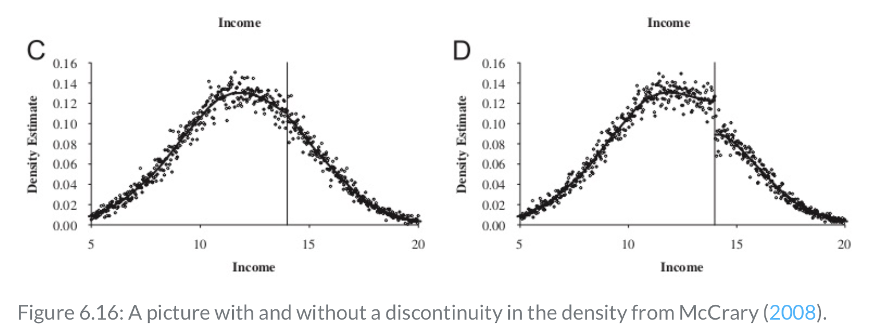
Challenges to Identification
McCrary Test

Slide 75
Challenges to Identification
Covariate Balance and Placebo Tests
Covariate Balance Tests
We can indirectly test the continuity assumption with covariate balance
There should be no discontinuous jumps at the cutoff, only the treatment and outcome
Placebo Tests
Fake Cutoffs are another indirect test of the continuity assumption
We should expect no discontinuous jumps at the fake cutoff in the outcome
Imbens and Lemieux (2008) suggest using the median running value as a fake cutoff or $c_{fake}$

Slide 76
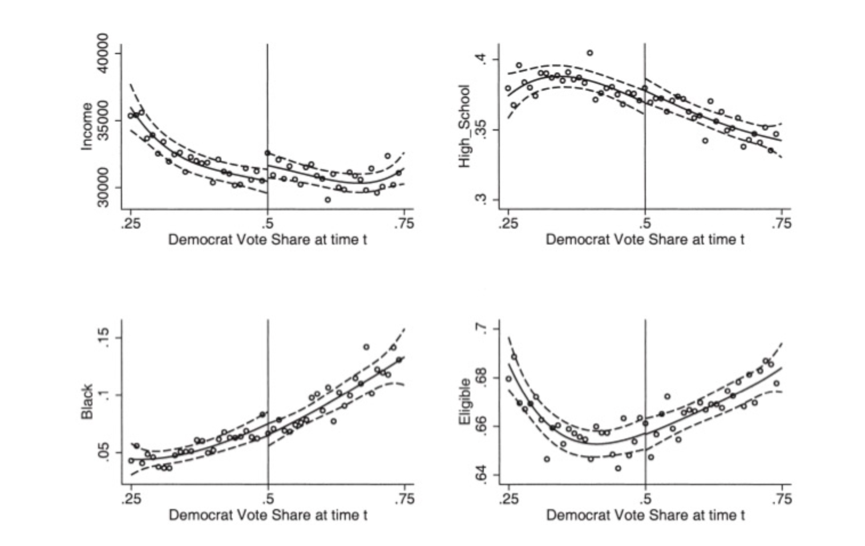
Challenges to Identification
Covariate Balance and Placebo Tests

Slide 77
Challenges to Identification
Nonrandom Heaping
We have seen how nonrandom sorting around the cutoff on the running variable contaminates the estimator with bias
Almond, Doyle, Kowalski, and Williams (2010) are interested in medical expenditures on health outcomes
If a physician perceives that an intervention will be beneficial then it is likely that the physician will assign treatment to a patient
Babies with low-birth weight receive heighten medical attention
The authors find that 1-year mortality decreases 1 percentage point and considering the mean of 5.5 percent chance, this is a large decrease

Slide 78
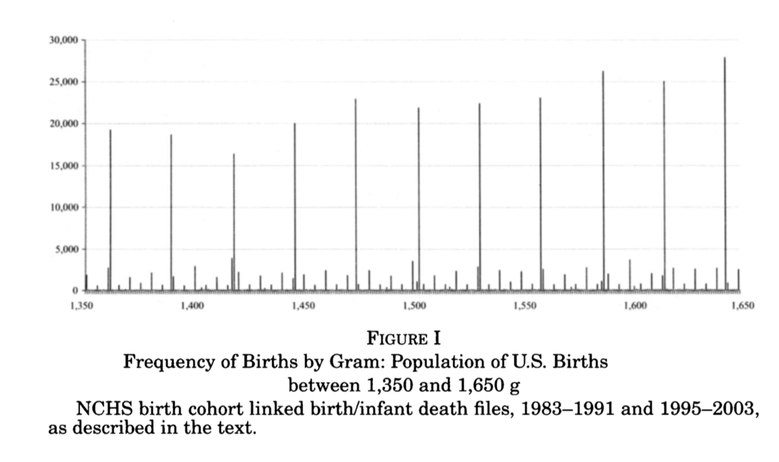
Challenges to Identification
Nonrandom Heaping
Berreca, Guildi, Lindo, and Waddell (2011) note that heaping occurs with baby birth weights
Heaping
When excessive number of units occur at certain points along the running variable
Birth weights appear to suffer from heaping and round to the nearest 5
Doctors may be rounding down to get low-birth weight intervention
This highlights a shortcoming of the McCrary Test, since Almond, et al. (2010) failed to reject the null hypothesis
A “donut hole” RDD is a potential solution to heaping

Slide 79
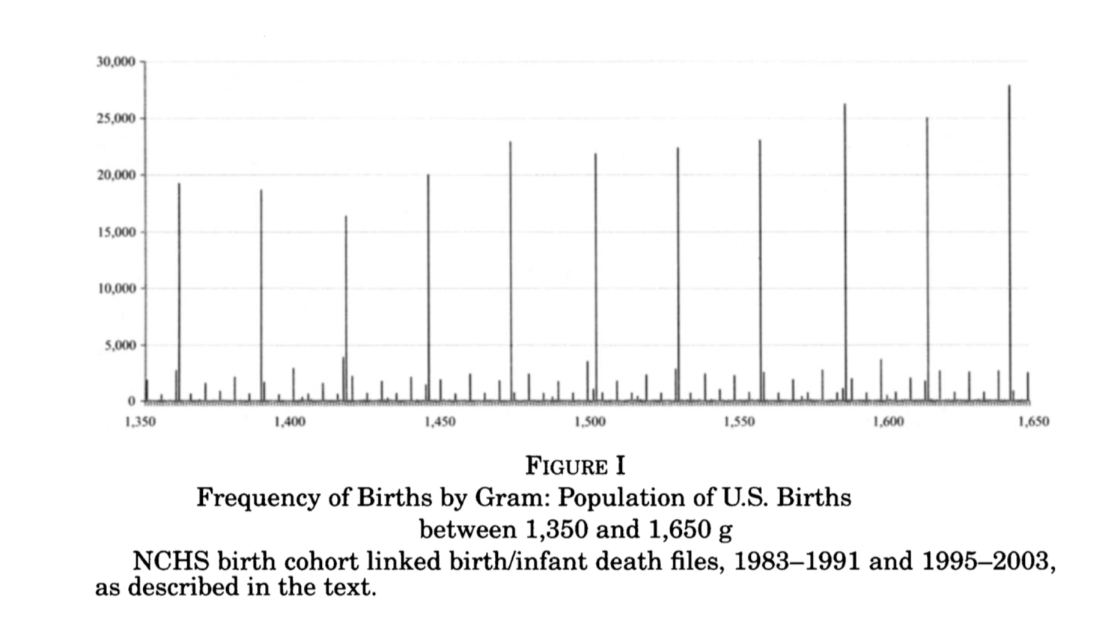
Challenges to Identification
Nonrandom Heaping

Slide 80
RDD Example: Close Elections
Lee, Moretti, and Butler (2004)
Lee, Moretti, and Butler (2004) want to answer the question
Do voters pick politicians or policies?
Convergence Theory
Heterogenous voter ideology forces each candidate to moderate this or her position (similar to median voter theorem)
Divergence Theory
The winning candidate pursues his or her most-preferred policies
The authors focus on very narrow elections by margins less than 2% in 1992

Slide 81
RDD Example: Close Elections
Lee, Moretti, and Butler (2004)
Theoretical Framework
For policy preferences under a quadratic loss function of $u(l)=-(1/2)(l-c)^{2}$ for Democratic party and $v(l)=-(1/2)l^{2}$ for Republican party
Democratic “bliss point is when $c>0$ and Republican “bliss point” is when $c=0$
Before election $t$, voters develop policy expectations denoted $x^{e}$ and $y^{e}$ for Democratic and Republican nominee, respectively
The probability of party $D$ winning is $P$ and $P(x^{e},y^{e})$ is a function of $x^{e}$ and $y^{e}$
$t$ is the 1992 November election and $RC_{t}$ means the 1993-1994 Congressional session
$t+1$ is 1994 November election and $RC_{t+1}$ is the 1994-1995 Congressional sessions

Slide 82
RDD Example: Close Elections
Lee, Moretti, and Butler (2004)
Alesina (1988) shows that there is a efficient frontier by $x^{*}=y^{*}=λc$ where $λ∈(0,1)$, where $x^{*}$ and $y^{*}$ are policy equilibrium points
There are 3 Nash equilibria
Complete convergence
$x^{*}=y^{*}=λ^{*}c$ where $λ^{*}$ is Nash bargaining equilibrium
When $\frac{dx^{*}}{dP^{*}}>0,\frac{dy^{*}}{dP^{*}}>0$, where an exogenous marginal increase in party $D$ popularity $P^{*}$ pulls both parties, so voter’s affect candidates’ policy choices
It is irrelevant for policy which party is actually elected

Slide 83
RDD Example: Close Elections
Lee, Moretti, and Butler (2004)
Partial convergence
$$0≤y^{*}≤x^{*}≤c$$
Is $\frac{dx^{*}}{dP^{*}}>0,\frac{dy^{*}}{dP^{*}}>0$ robust to minor deviation?
Both parties may be better off moving closer to their bliss points, but with an exogenously higher $P^{*}$, party $D$ has better “bargaining position” and can converge towards $c$, which is the party $D$ bliss point
The authors note that partial convergence is a more likely equilibrium than complete convergence, so they focus on partial convergence moving forward

Slide 84
RDD Example: Close Elections
Lee, Moretti, and Butler (2004)
Complete divergence
$x^{*}=c$ and $y=0$
In this equilibrium, voters expect parties to carry out their bliss points
$$\frac{dx^{*}}{dP^{*}}=\frac{dy^{*}}{dP^{*}}=0$$
An exogenous marginal shock in party $D$ popularity, $P^{*}$, has no impact on candidates positions
Voters only elect politicians not policies

Slide 85
RDD Example: Close Elections
Lee, Moretti, and Butler (2004) Empirical Framework
Roll-call voting record is denoted
$$RC_{t}=(1-D_{t})y_{t}+D_{t}x_{t}$$
Where $D_{t}$ is an indicator of the Democratic nominee won election $t$, and only the winning candidate’s policy is observable
We can transform roll-call voting record from the prior expression to:
$RC_{t}=α+π_{0}P_{t}^{*}+π_{1}D_{t}+ε_{t}$ and $RC_{t+1}=α+π_{0}P_{t+1}^{*}+π_{1}D_{t+1}+ε_{t+1}$
Where $P^{*}$ is a measure of the electoral strength “popularity” of party $D$, which is the probability of a party $D$ victory at fixed platforms $c$ and 0; $P$ is the probability that party $D$ will win
$ε$ is the heterogeneity in bliss points across districts

Slide 86
RDD Example: Close Elections
Lee, Moretti, and Butler (2004) Empirical Framework
Our interest is $π_{0}$
When $π_{0}>0$ we have partial convergence
When $π_{0}=0$, we have complete divergence
The prior equations allow use to parameterize the derivatives $\frac{dx^{*}}{dP^{*}}$ and $\frac{dy^{*}}{dP^{*}}$ as $π_{0}$
We cannot directly estimate this equation because we never observe $P^{*}$
We do observe $D$ and can estimate $π_{1}$, which is an important determinant of roll-call voting records

Slide 87
RDD Example: Close Elections
Lee, Moretti, and Butler (2004) Empirical Framework
Suppose we randomize $D_{t}$, then $D_{t}⊥P^{*}$ and $D_{t}⊥ε_{t}$
If bliss points are exogenous and not influenced by who won the prior election, then $D_{t}$ will have no impact on $ε_{t+1}$
We have three equations to back out $π_{0}$
$$E[RC_{t+1}|D_{t}=1]-E[RC_{t+1}|D_{t}=0]=π_{0}[P_{t+1}^{*D}-P_{t+1}^{*R}]+π_{1}[P_{t+1}^{D}-P_{t+1}^{R}]=γ$$
Where $γ$ is the total effect on initial win on future roll-call votes and we don’t observe $P^{*}$ and $π_{0}$
$P_{t+1}^{D}$ is the equilibrium probability of a Democratic victor in $t+1$; $P_{t+1}^{*D}$ is electoral strength
$$E[RC_{t}|D_{t}=1]-E[RC_{t}|D_{t}=0]=π_{1}$$
$$E[D_{t+1}|D_{t}=1]-E[D_{t+1}|D_{t}=0]=P_{t+1}^{D}-P_{t+1}^{R}$$

Slide 88
RDD Example: Close Elections
Lee, Moretti, and Butler (2004) Empirical Framework
1) $E[RC_{t+1}|D_{t}=1]-E[RC_{t+1}|D_{t}=0]=π_{0}[P_{t+1}^{*D}-P_{t+1}^{*R}]+π_{1}[P_{t+1}^{D}-P_{t+1}^{R}]=γ$
This shows the total effect of $γ$ of a Democratic victory in election $t$ on roll-call voting in congressional session $t+1$
The first component is the unobserved “affect” component
The second component is observed “elect” component
2) $E[RC_{t}|D_{t}=1]-E[RC_{t}|D_{t}=0]=π_{1}$
3) $E[D_{t+1}|D_{t}=1]-E[D_{t+1}|D_{t}=0]=P_{t+1}^{D}-P_{t+1}^{R}$

Slide 89
RDD Example: Close Elections
Lee, Moretti, and Butler (2004) Empirical Framework
We can estimates of $γ$, $π_{1}$, and $P_{t+1}^{D}-P_{t+1}^{R}$ from our three equations
We can estimate “affect” by backing out $π_{0}[P_{t+1}^{*D}-P_{t+1}^{*R}]$ by$γ-π_{1}[P_{t+1}^{D}-P_{t+1}^{R}]$
If voters merely “elect” policies (complete divergence), then $π_{0}[P_{t+1}^{*D}-P_{t+1}^{*R}]$ should be small
If voters affect policies (partial convergence), then $π_{0}[P_{t+1}^{*D}-P_{t+1}^{*R}]$ will be large
How much of $γ$ is explained by “elect” vs “affect”?

Slide 90
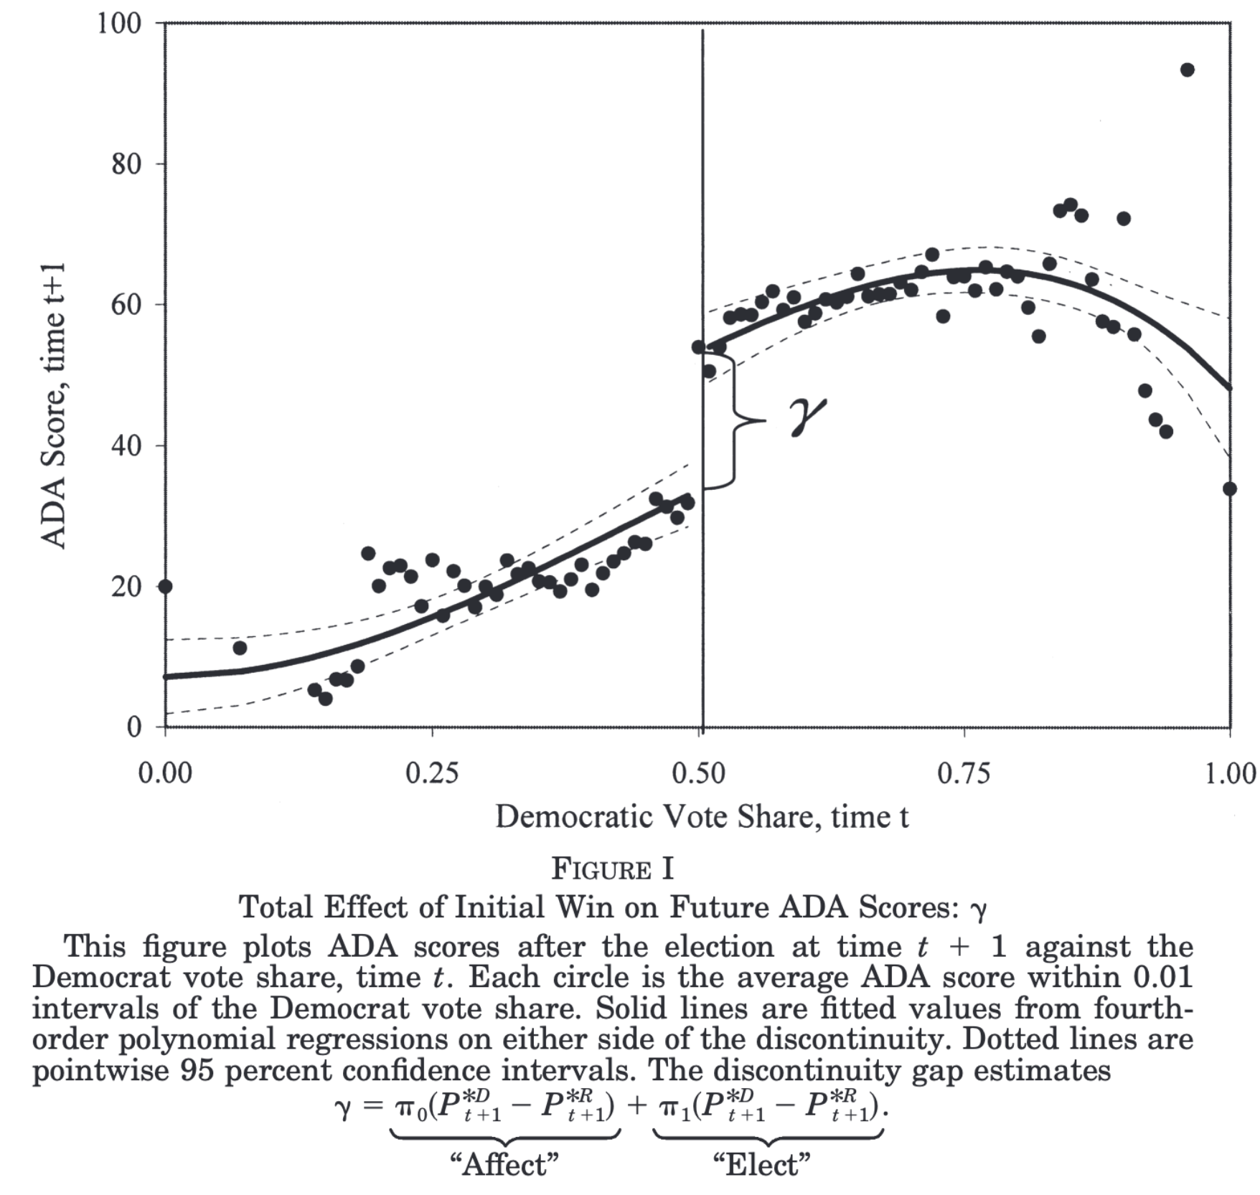
RDD Example: Close Elections
Lee, Moretti, and Butler (2004) Empirical Framework

Slide 91
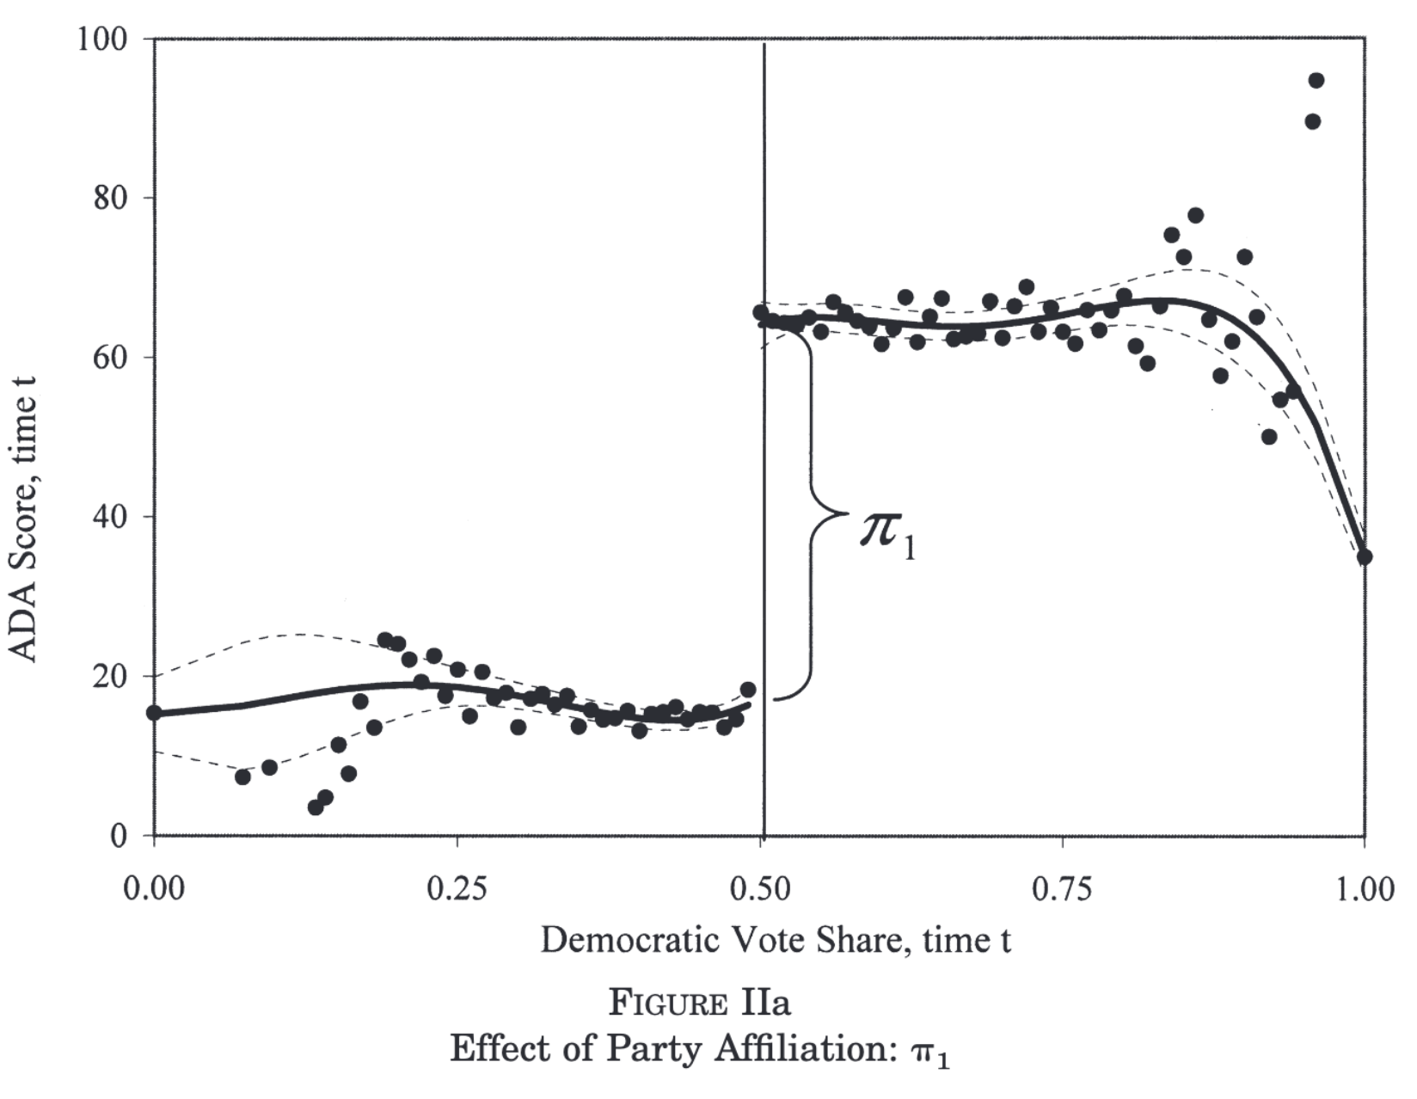
RDD Example: Close Elections
Lee, Moretti, and Butler (2004) Empirical Framework

Slide 92
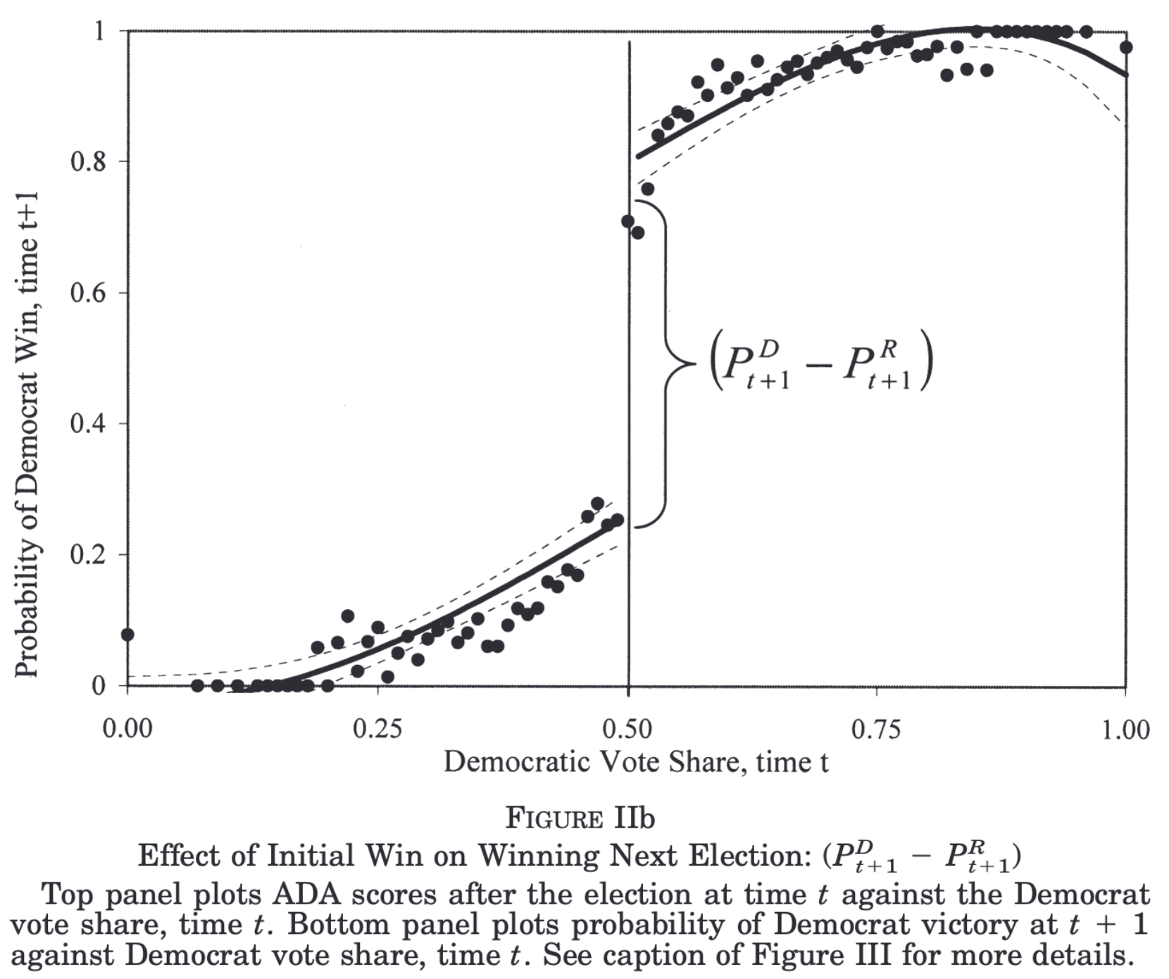
RDD Example: Close Elections
Lee, Moretti, and Butler (2004) Empirical Framework

Slide 93
RDD Example: Close Elections
Lee, Moretti, and Butler (2004)
Lee, et al. (2004) argue that close elections are “good as random” and isolates the effect of $D_{t}$
Data
Roll-call voting records are obtained from Americans for Democratic Action (ADA) linked with House of Representative elections for 1946-1995
The Running Variable
Voting share in an election is the running variable with a cutoff at 50%
The window is 2% around the cutoff, so 48% to 52% is the sample used

Slide 94
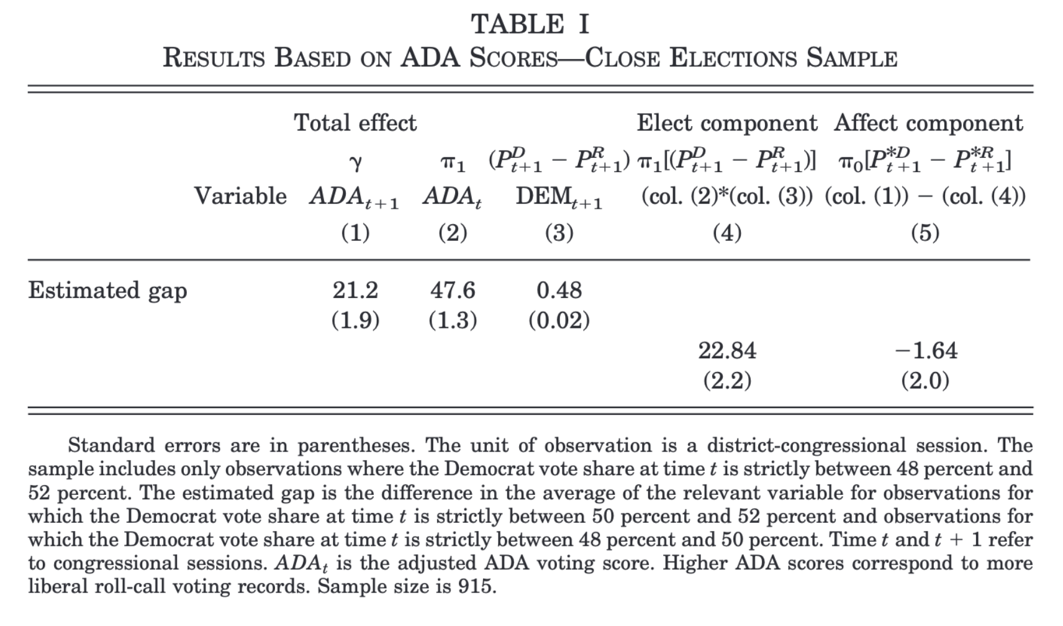
RDD Example: Close Elections
Lee, Moretti, and Butler (2004)
These are the results $γ$, $π_{1}$, and $P_{t+1}^{D}-P_{t+1}^{R}$
$π_{0}[P_{t+1}^{*D}-P_{t+1}^{*R}]$ is small and insignificant
This supports the complete divergence theory
The “elect” component is more important than “affect”

Slide 95
RDD Example: Close Elections
Lee, Moretti, and Butler (2004)
Stata Exercise to replicate Lee, Moretti, and Butler (2004)

Slide 96
Regression Kink Design
Sometimes a discontinuity does not describe what happens at a cutoff
Card, Lee, Pei, and Weber (2015) discuss regression kink design
Instead of a discontinuous jump at a cutoff, a change in the first derivative (slope) occurs at the cutoff
Kinks in the slope are often embedded in policy rules
We can identify causal effects by exploiting a change in the slope at the cutoff

Slide 97
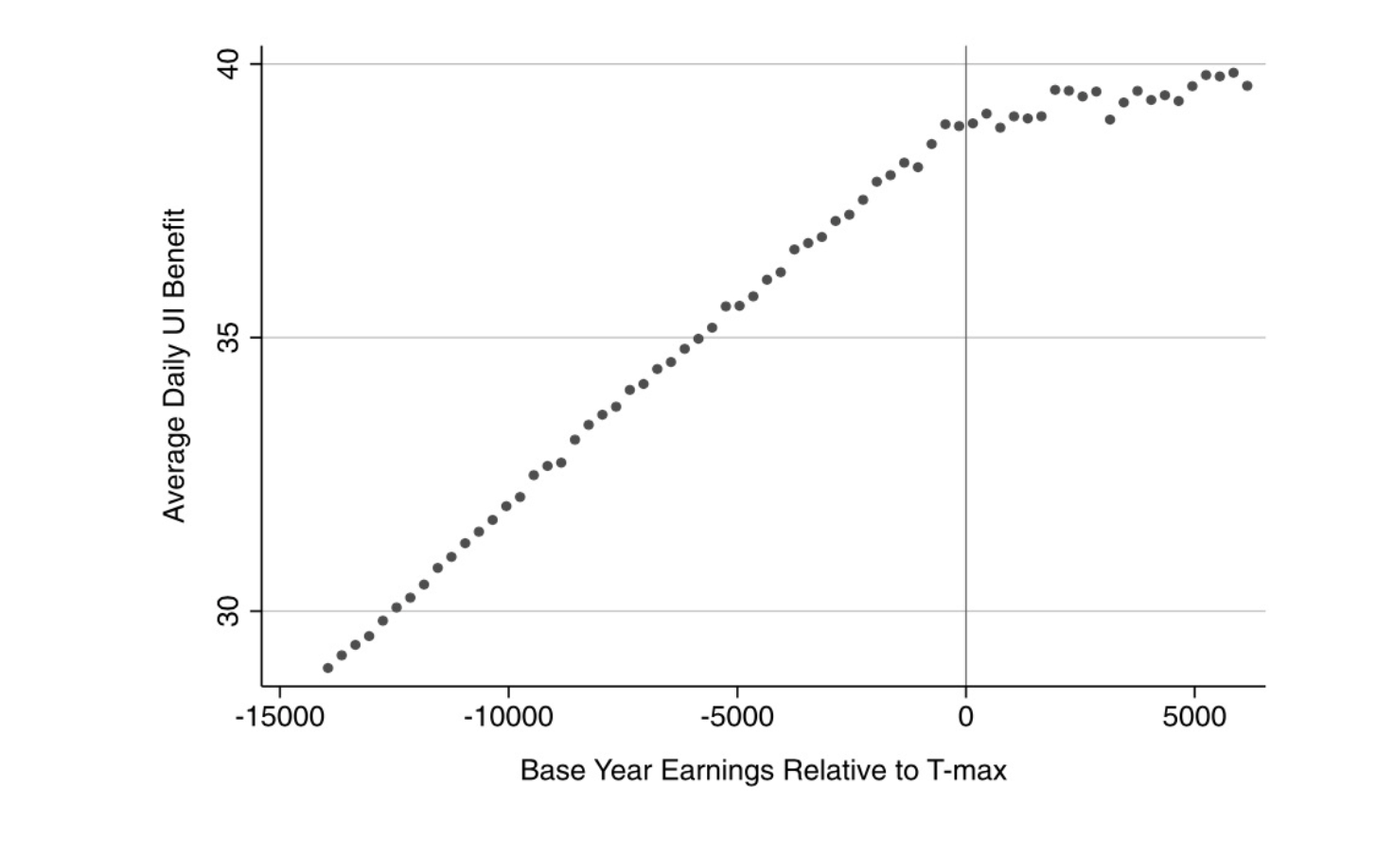
Regression Kink Design

